Slide 1
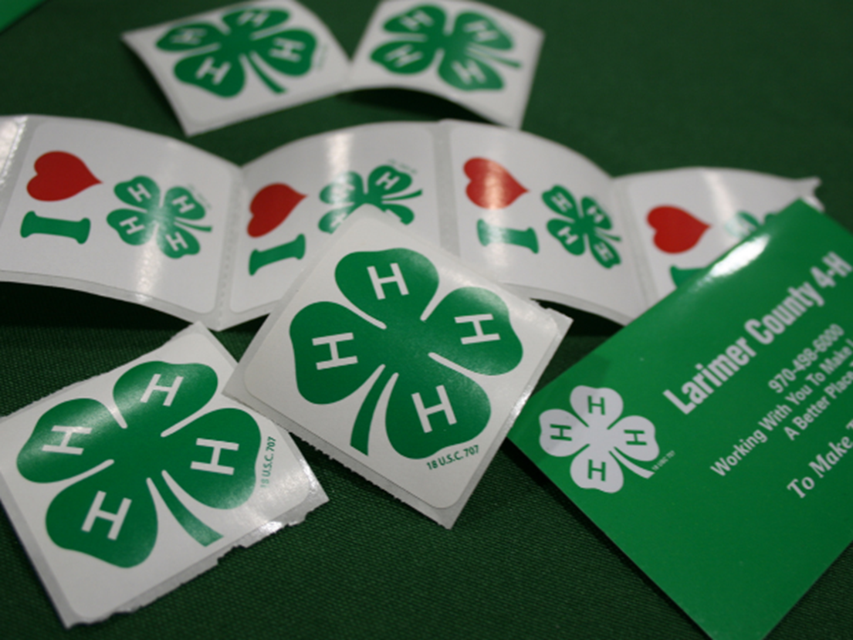
Colorado 4-H YD Professionals
Monthly Gathering
June 11, 2024
Notes:
Michael

Slide 2
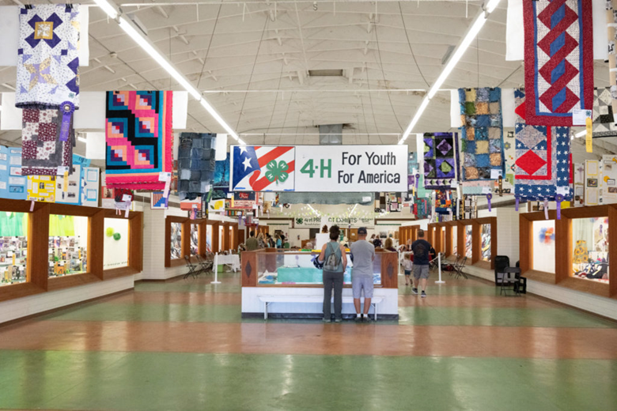
Chat box icebreaker
What is one 4-H related experience you are excited for this summer?

Slide 3
Agenda:
Purpose & updates
State 4-H Conference
State Fair
Engagement & Expansion
Q&A
Wrap Up

Slide 4
Colorado 4-H Mission
4-H empowers youth to reach their full potential by working and learning in partnership with caring adults.
Colorado 4-H Vision
A world in which youth and adults learn, grow and work together.
Forward Together, Mission, Motion, Movement

Slide 5
Purpose: Monthly 4-H YD Gatherings
Bring our state 4-H PYD professionals together (county, region, state)
Share vision, purpose and strategic PYD outcomes
Provide timely information, resources and training for 4-H professionals across the state
Provide opportunity to ask questions, receive answers and share ideas

Slide 6
Colorado 4-H YD
State Updates

Slide 7
State 4-H Team Responsibilities
Champion the mission
Drive the vision
System wide strategic planning
Serve as content experts
Support programmatic needs

Slide 8
State 4-H Team Responsibilities
Training & onboarding
Provide resources
Develop Partnerships
Organize state events
Respond to need
Collaborate & communicate
Generate funding

Slide 9
State 4-H Team
State Program Director
State Specialists:
Animal Science
Budget, project management, events coordination, admin support
Civic Engagement & Curriculum
Data & IT
Expansion & Engagement
Equine
Military partnerships
Shooting Sports
State 4-H Office Assistant
STEM
Volunteer Development

Slide 10
Program Priorities
Systems Thinking
Strategic Planning
Quality
Access
Parity

Slide 11
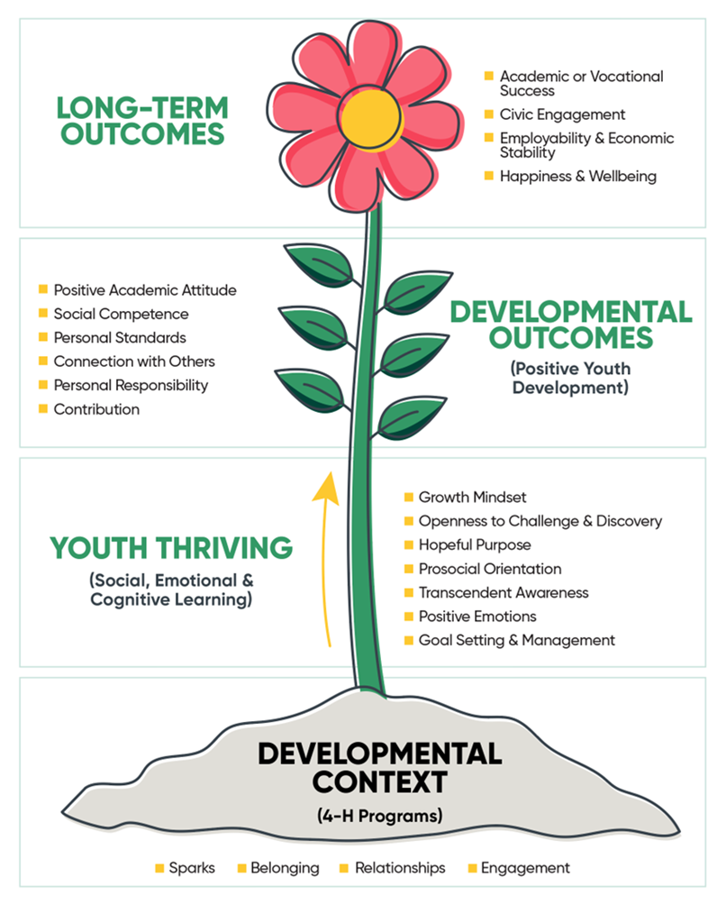
Program Priorities
Responsive
Proactive
Program driven
Based on PYD

Slide 12
Internal
Communication

Slide 13
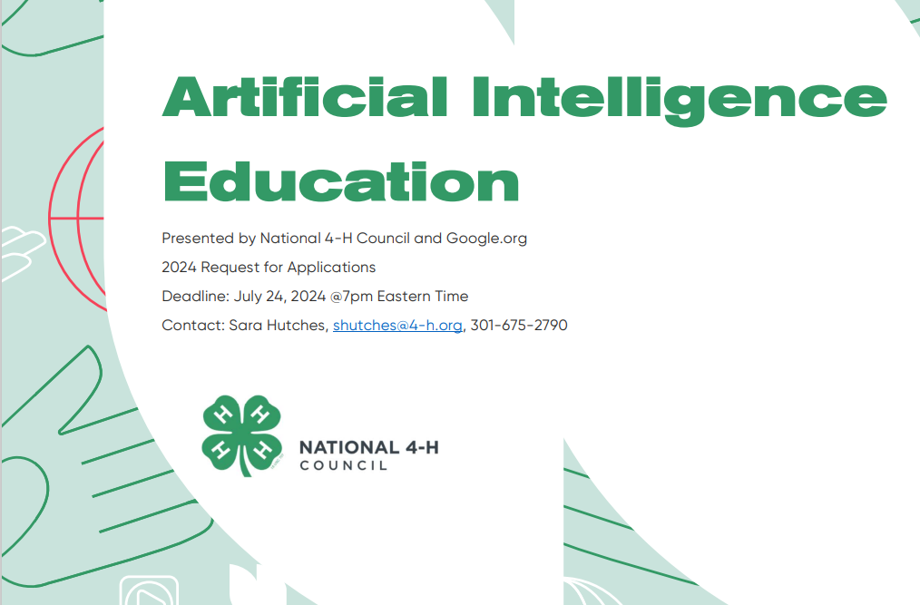
Artificial Intelligence & Agriculture
Sub-grant

Slide 14
Parking and Street Closures: Conference Lots only, Equine Center, and Laurel Street closure
State Conference Invoices: All have been sent
Reminders: Water bottle, good walking shoes, lost room keys, workshop tracks and contests, code of conduct and more!
CAM the Ram Appearance!
State 4-H Conference

Slide 15
State Fair General/FCS Exhibit Schedule
August 5, 5:00pm - All exhibits to be entered in FairEntry.
August 13 - Teen Clerk/Volunteer check-in and exhibit drop off. Exhibits must be dropped off at your assigned time in the appropriate building at the state fairgrounds.
Superintendents can check in projects on Aug. 12.
August 14-15 - Project Judging
August 16-18 - Project Display
Superintendents stay Friday to assist with display setup
State Fair

Slide 16
State Fair General/FCS Exhibit Schedule
September 3 - All those picking up exhibits must arrive by 9:00am to assist with project take down. We will begin in the 4-H Exhibit Hall taking down and sorting all projects by county. Then we will move to the Dining Hall and then the Auditorium.
DO NOT start loading your projects until all three buildings have been taken down and projects sorted by county.
The buildings will be closed at 1:30pm, so projects left after that are the responsibility of the county.
Please tell your volunteers this information if you are not the one picking up projects.
4-H YD @
State Fair

Slide 17
State Fair 4-H Contests
July 15 – Digital Photo Contest deadline.
4-H members submit entries directly into FairEntry.
August 5 - Contest entry deadline, including for 4-H Agility Trials
Agility Trials are Aug. 17 and 18 at El Paso Co. Fairgrounds, Calhan
Group Leader Sign-up and Schedule are posted for Fashion Revue
August 25 - Entry deadline for State 4-H Dog Trials
State Dog Trials are Sept. 14-15 at State Fairgrounds, Pueblo
We will be sending out a volunteer sign-up for the Dog Trials in the 4-H newsletter.
Monitor this website for updates:
https://co4h.colostate.edu/state-fair-information/
4-H YD @
State Fair

Slide 18
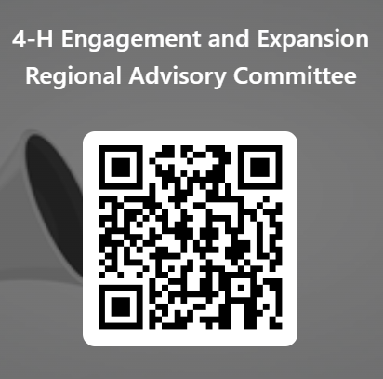
Submit Nominations!
4-H Engagement and Expansion Regional Advisory Committee
Who: 4-H Directors, Specialists, Coordinators, Interpreters
What: Improving Outreach, Enhancing Engagement, and Supporting Parity Initiatives
Notes:
Current Priorities:
Regional 4-H Parity and Advisory Board Data
Worked with Martha Thomas to find some hidden data for some of the counties.
In the process of adding the new data.
After meeting with the RDs in April and with Michael, I am working to create a draft “Guide” to support the plans. This will be presented to the RDs to get some feedback, and hopefully provide opportunities for conversations on how move forward.
4-H Regional Advisory Committee Nominations Open
Goals/Purpose:
Connect, Collaborate, and Share Ideas
4-H Engagement Outreach Pilot
It’s an Outreach Pilot to engage with underserved and underrepresented populations (youth and families) from the southern region.
And it’s an opportunity to capitalize on the events surrounding the state fair and an opportunity to expand our partnership with CSU Pueblo.
From the field:
Arapahoe County
Douglas County

Slide 19
Submit Nominations!
4-H Engagement and Expansion Regional Advisory Committee
Deadline: Friday, June 21, 2024
New Members Announced: July 2024 4-H Newsletter
1st Meeting: September 2024
Notes:
Current Priorities:
Regional 4-H Parity and Advisory Board Data
Worked with Martha Thomas to find some hidden data for some of the counties.
In the process of adding the new data.
After meeting with the RDs in April and with Michael, I am working to create a draft “Guide” to support the plans. This will be presented to the RDs to get some feedback, and hopefully provide opportunities for conversations on how move forward.
4-H Regional Advisory Committee Nominations Open
Goals/Purpose:
Connect, Collaborate, and Share Ideas
4-H Engagement Outreach Pilot
It’s an Outreach Pilot to engage with underserved and underrepresented populations (youth and families) from the southern region.
And it’s an opportunity to capitalize on the events surrounding the state fair and an opportunity to expand our partnership with CSU Pueblo.
From the field:
Arapahoe County
Douglas County

Slide 20
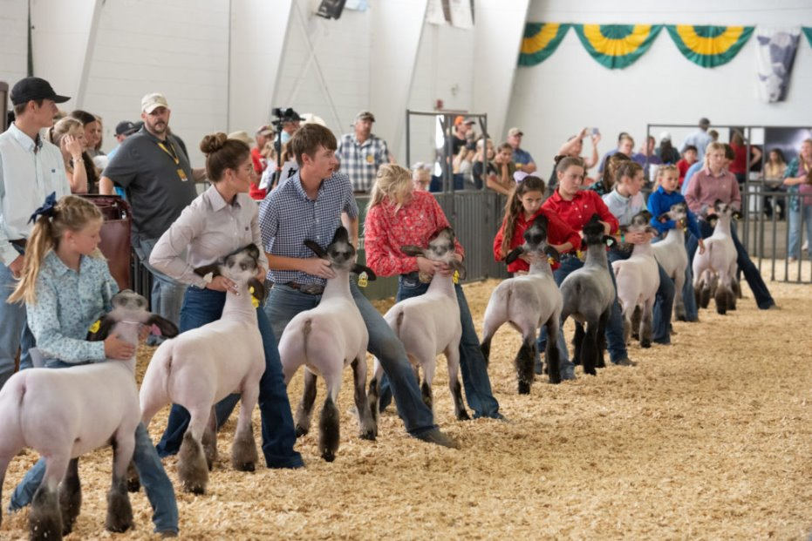
Questions?

Slide 21
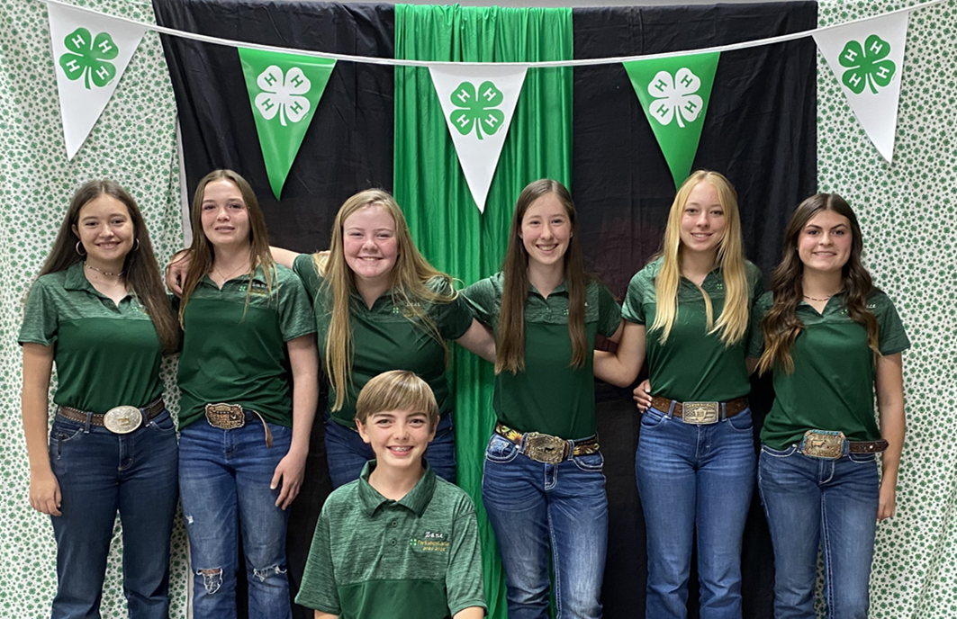
Thank you!
See you
July 9th

