Slide 1
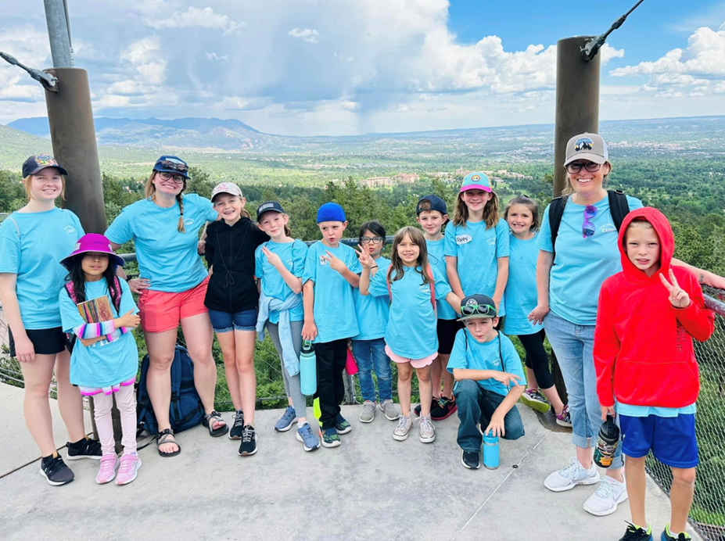
Colorado 4-H YD Professionals
Monthly Gathering
April 9, 2024
Notes:
Michael

Slide 2
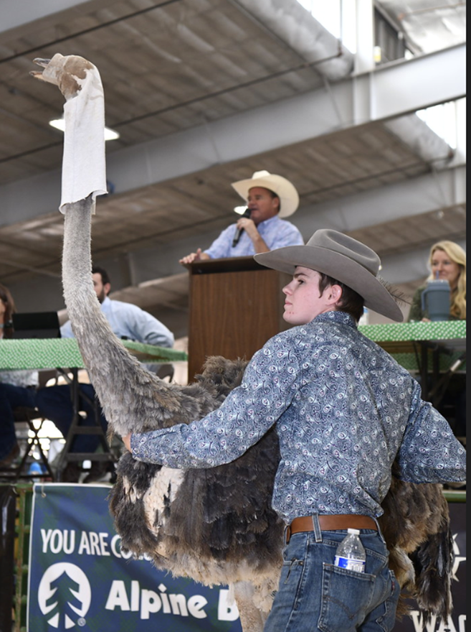
Chat box icebreaker
What is one thing that makes you unique?
Eagle County

Slide 3
Agenda:
Purpose & updates
Program highlights
April Deep Dive:
Club chartering
Club revocation & IRS updates
Q&A
Wrap Up

Slide 4
Colorado 4-H Mission
4-H empowers youth to reach their full potential by working and learning in partnership with caring adults.
Colorado 4-H Vision
A world in which youth and adults learn, grow and work together.

Slide 5
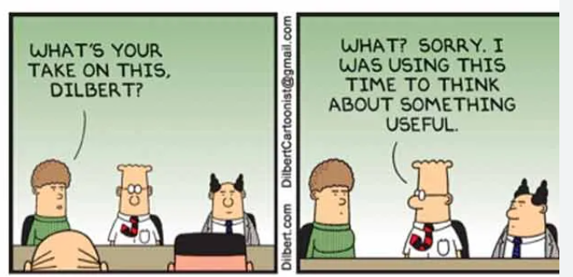
Driven by Purpose

Slide 6
Purpose: Monthly 4-H YD Gatherings
Bring our state 4-H PYD professionals together (county, region, state)
Share vision, purpose and strategic PYD outcomes
Provide timely information, resources and training for 4-H professionals across the state
Provide opportunity to ask questions, receive answers and share ideas

Slide 7
Purpose: Monthly 4-H YD Gatherings
Bring our state 4-H PYD professionals together (county, region, state)
Share vision, purpose and strategic PYD outcomes
Provide timely information, resources and training for 4-H professionals across the state
Provide opportunity to ask questions, receive answers and share ideas

Slide 8
Purpose: Monthly 4-H YD Gatherings
Bring our state 4-H PYD professionals together (county, region, state)
Share vision, purpose and strategic PYD outcomes
Provide timely information, resources and training for 4-H professionals across the state
Provide opportunity to ask questions, receive answers and share ideas

Slide 9
Purpose: Monthly 4-H YD Gatherings
Bring our state 4-H PYD professionals together (county, region, state)
Share vision, purpose and strategic PYD outcomes
Provide timely information, resources and training for 4-H professionals across the state
Provide opportunity to ask questions, receive answers and share ideas

Slide 10
Monthly 4-H YD Gatherings
Structure
4-H Specialist/Coordinator host
Director updates
Featured 4-H county program showcasing
State Specialist updates
Deep Dive topic of the month
Wrap up

Slide 11
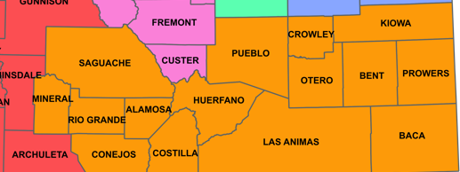
Monthly 4-H YD Gatherings
May,14, 2024
Southern Region
1 Host
2 Program showcases

Slide 12
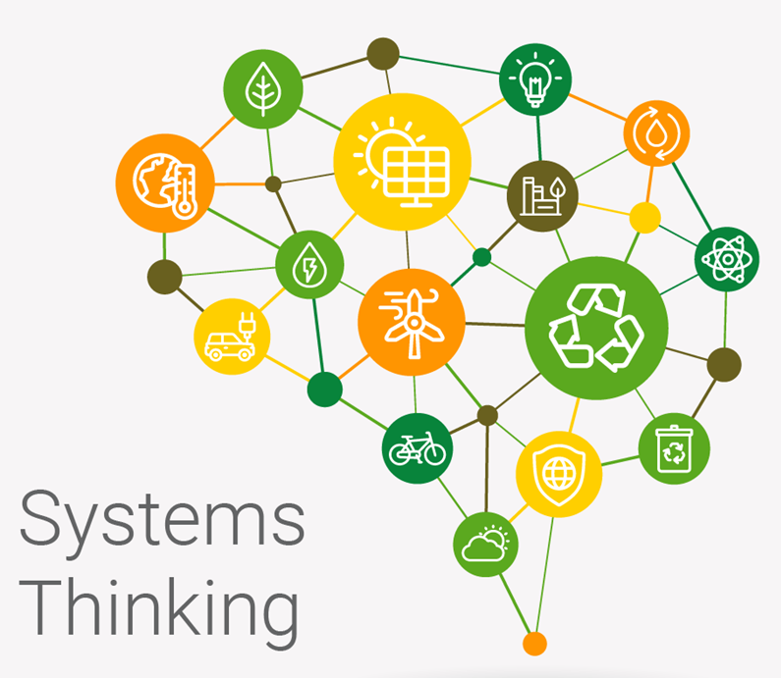
The process of understanding how things influence one another to a larger whole
It’s an ecosystem – air, water movement, plants, animals work together
Consists of people, structures, and processes in collaboration
Create a healthy, dynamic and effective organization

Slide 13
Change our thinking to match the complexity of our environment (Extension)
Communicate & collaborate to create new ways to problem solve
Identify and test a variety of actions that lead to solutions
Be aware of unintended consequences of our actions
Expand available options for impact

Slide 14
Change our thinking to match the complexity of our environment (Extension)
Communicate & collaborate to create new ways to problem solve
Identify and test a variety of actions that lead to solutions
Be aware of unintended consequences of our actions
Expand available options for impact

Slide 15
Change our thinking to match the complexity of our environment (Extension)
Communicate & collaborate to create new ways to problem solve
Identify and test a variety of actions that lead to solutions
Be aware of unintended consequences of our actions
Expand available options for impact

Slide 16
Change our thinking to match the complexity of our environment (Extension)
Communicate & collaborate to create new ways to problem solve
Identify and test a variety of actions that lead to solutions
Be aware of unintended consequences of our actions
Expand available options for impact

Slide 17
Change our thinking to match the complexity of our environment (Extension)
Communicate & collaborate to create new ways to problem solve
Identify and test a variety of actions that lead to solutions
Be aware of unintended consequences of our actions
Expand available options for impact

Slide 18
Internal Communication

Slide 19
State 4-H
Newsletter

Slide 20
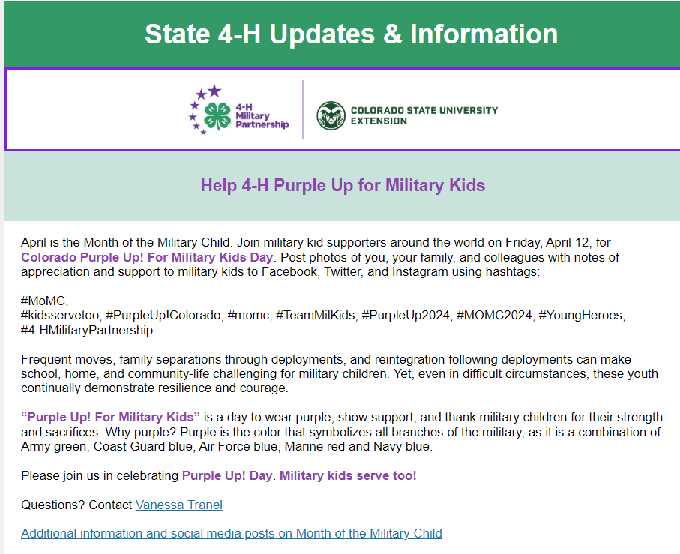
State 4-H
Newsletter

Slide 21
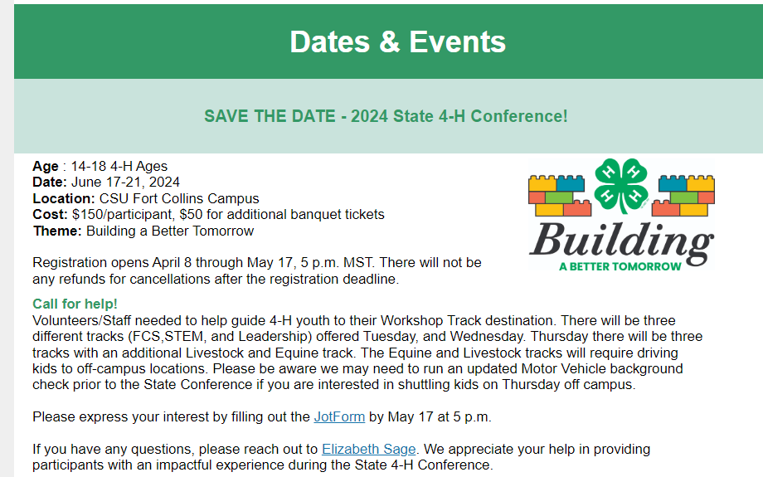
State 4-H
Newsletter

Slide 22
Animal Science/Livestock Specialist - April
Assistant Office Coordinator
- April
Shooting Sports Specialist
- Summer 2024
Volunteer Systems Specialist
- Fall 2024
State 4-H Team Positions

Slide 23
Forward Together: Mission, Motion, Movement

Slide 24
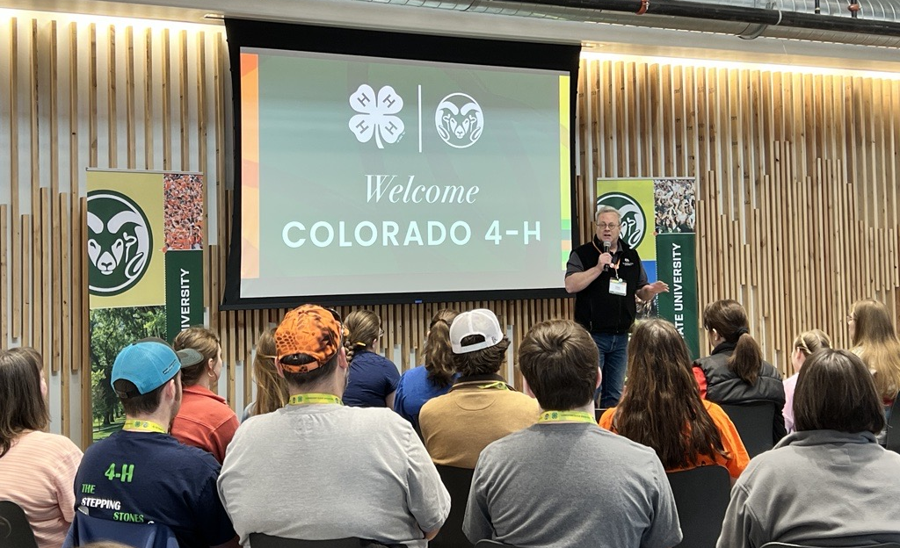
Colorado 4-H Program Showcase:
STEM

Slide 25
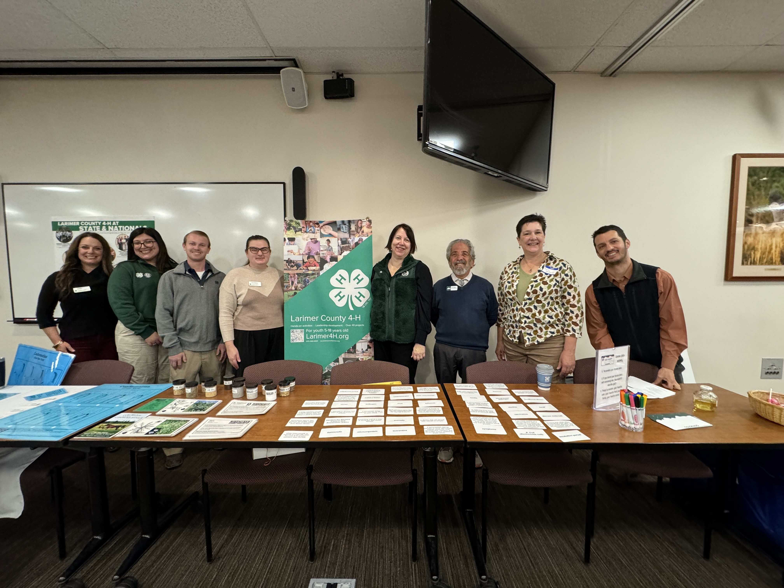
Colorado 4-H Program Showcase:
Engagement and Expansion

Slide 26
2024-2025 Club/Group Chartering
Simplify
Combined Documents
Charter Checklist
Revocation Letters & IRS Updates
What happened?
What was learned?
Moving forward

Slide 27
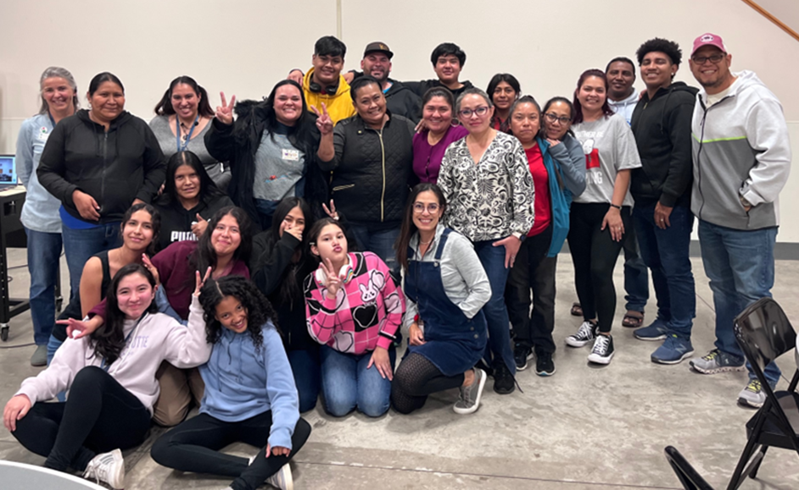
Questions?
Juntos 4-H Gunnison County

Slide 28
2024 State 4-H Conference: June 17th – 21st
Location:
CSU Campus
Registration:
April 8th - May 17th
Notes:
Michael

Slide 29
2024 State 4-H Conference: June 17th – 21st
Cost:
$150 participant
Vol/Staff help needed
https://form.jotform.com/240916503309049
Notes:
Michael

Slide 30
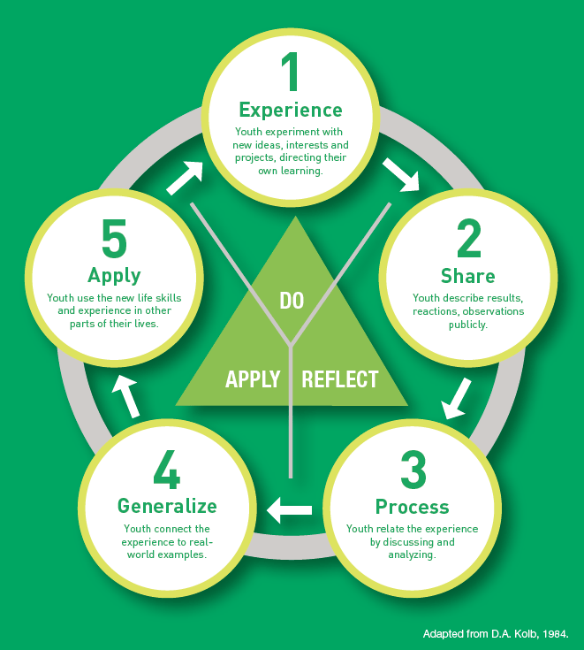
Chat box reflection
What did you learn?

Slide 31
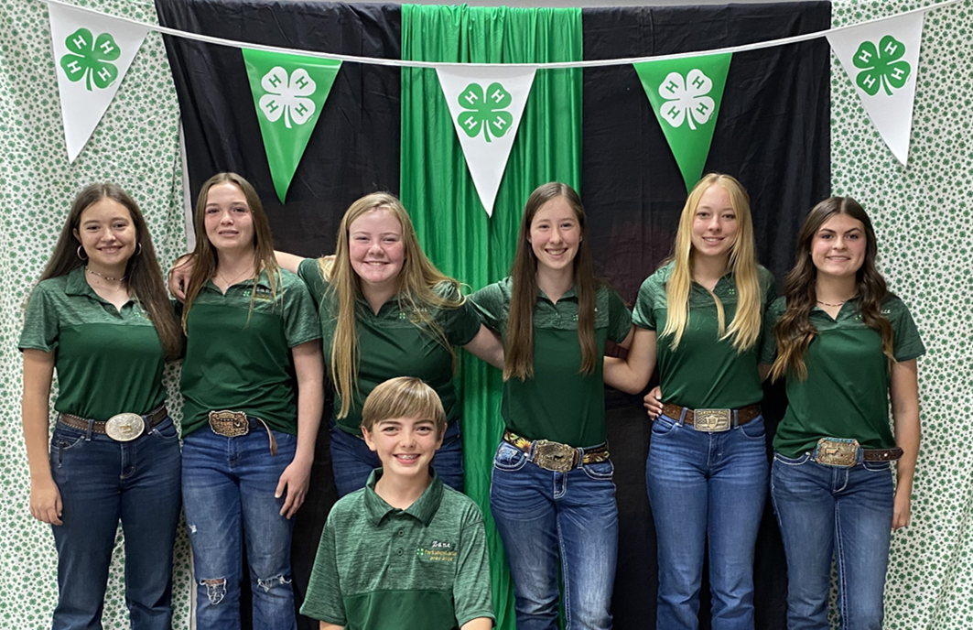
Thank you!
See you
May 14th
Montezuma County

