Slide 1
Vanessa Tranel
Colorado State University Extension
4-H Youth Development, Specialist – Military
8 January 2019
4-H Name and Emblem Usage
Notes:
It’s REALLY important as we create t-shirts, flyers, posters and marketing materials – and as clubs and 4-H groups do the same - that we do it correctly and within the guidelines and rules.
What we are going to talk about the few minutes is pretty basic information about the 4-H Name and Emblem Usage – for some of us more “seasoned” staff – it’s a good refresher and for some who are less seasoned, it may be new .

Slide 2







A Picture is Worth 1000 Words…
Notes:
They say a picture is worth 1000 words – especially if the picture is a recognizable symbol. But, that’s only if the symbol remains consistent. As we look at these graphics – we can easily recognize all of them. For example: McDonald’s are always the “golden arches”, with very few exceptions. (Montrose, CO, Sedona, AZ, a few foreign countries). The RED CROSS is the RED CROSS, not the ORANGE CROSS. Bottom line – they are recognizable.

Slide 3
What’s In A Name?
Belonging – Identity – Recognition – Program Ideals – Shortcuts for the brain
4-H Name and Emblem are federally protected by the Secretary of Agriculture
  Like the Presidential Seal and the Olympic Emblem
  More unique and special than a trademark or copyright
Notes:
Why is it important to be so picky about an emblem and branding of an organization? Belonging-Identity-Recognition…
The 4-H Name and Emblem are special and are federally protected – GO TO NEXT PAGE…

Slide 4


Does Anyone REALLY Own a Name?
USDA Secretary of Agriculture
USDA/NIFA – 4-H National Headquarters
Land Grant University Extension Directors/State 4-H Office
Local Extension Offices
Notes:
YES he or she does!
The 4-H Emblem so valued, it was granted a unique and special status; it is in a category similar to the Presidential Seal and the Olympic Emblem. This federal protection makes it a mark into and of itself with protection that supercedes the limited authorities of both a trademark and a copyright. As a result, responsibility and stewardship for the 4-H Name & Emblem were not given to the U.S. Patent Office but were given to a higher level of the federal government, a member of the Cabinet, the Secretary of Agriculture. The Secretary has responsibility for the 4-H Name and Emblem, at the direct request of Congress. The “18 USC 707” is the statement in the United States Code that outlines the protection of the 4-H Name & Emblem.
Sec. of Ag DELEGATES oversight of the 4-H Name and Emblem to USDA/NIFA 4-H Natl. HQ, etc.
State 4-H offices (through delegation by their land-grant institution’s Cooperative Extension office) are responsible for any 4-H Name and Emblem authorizations that cross local jurisdictions
Local 4-H offices (through delegation by their State 4-H office) are responsible for any 4-H Name and Emblem authorization limited to their local area of jurisdiction.
It is the legal responsibility of CES and USDA to insure the consistent and correct use of the 4-H Name and Emblem by all levels of salaried and volunteer Extension staff, 4-H participants, and authorized non-Extension entities. Equally important is the responsibility to communicate the significance of the 4-H Name and Emblem as a government-owned emblem that is protected by federal statute.
We AUTHORIZE USE of name/emblem.

Slide 5

Using the 4-H Name
4-H Name
  Numeral “4” separated from a capital “H” with a hyphen (not a dash, slash or space)
  Don’t use the emblem as replacement for any text of or within 4-H
    4 H
Notes:
In the English language – a numeral shouldn’t appear at the beginning of a sentence – which would be “Four-H”. So, it’s better to reword it, in keeping with the usage requirements.

Slide 6
Using the 4-H Emblem
Emblem…instead of a logo
Stem points to the right
“18USC707” must appear legibly to the right or below lower right leaf of clover and be same color
Keep emblem upright
Use the whole emblem
When clubs and 4-H individuals outside the office do fundraisers, create flyers, banners, posters, t-shirts, etc. they should be approved
Notes:
TITLE 18 – UNITED STATES CODE – SECTION 707 – lets the public know it’s a protected symbol owned by the federal govt
Example – Texas Holdem’ tournament for SS natl. shoot

Slide 7
Using the 4-H Emblem
Official 4-H Clover (downloaded from
  https://nifa.usda.gov/resource/4-h-professionals-handbook-4-h-name-and-emblem
CSUE 4-H graphic, go to staff resources – communications – graphics and logos

Slide 8
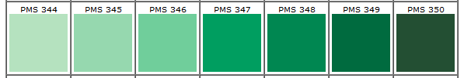

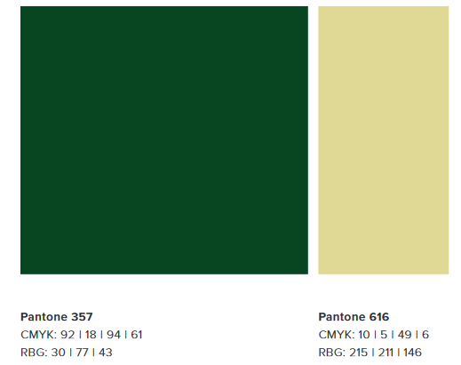
Colors of 4-H Emblem
Specified colors and in its entirety 100% PMS 347 Green (Pantone Color Matching System = standardized)
CSU Green
4-H Green

Slide 9

More on Color…
Clover can be black and H’s can be white.
Clover can be white and H’s can be white, green, or black.
Clover can be metallic gold and H’s can over can be green and H’s can be white, metallic gold and H’s white or black.
One color printing – green or black only accepted colors
Notes:
Clover can be white and H’s can be white (outlined in black), green, or black

Slide 10
What CAN’T We Do?
Flip, rotate, or turn on its side
Place over or obscure emblem with a photo, drawing, symbol, word or other figure or object.
Place text over on top of emblem
Superimpose an image over the top of one or more of the leaves
Never as a watermark
Use to imply endorsement of any product or material
Notes:
May not be used on or in association with products/services such as: animal feed, beauty products, beverages, food, insurance, pesticides…(pg 9)

Slide 11



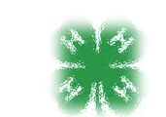



Inappropriate Use
Notes:
It’s all fun and games until someone gets fined up to $5000 or put in prison up to 6 months or BOTH! Actually, that’s for using it without permission.

Slide 12
SO…SO…SO…
4-H and extension staff – be familiar with basic use of 4-H Name and Emblem
Educate others who use the name and emblem – volunteers, 4-H members, clubs
WE are the guardian of the 4-H Name and Emblem
Know the resources online and ask for questions or for clarification of the State 4-H Office
Let’s be proud of the 4-H Name and Emblem and our image when approving t-shirts and creating flyers, posters, etc. ☺

